Slide 1
JEDI Project Presentation
On
FlipFit Gym Application
GROUP H

Slide 2
The Ask – Where we started?
As beginners in software development, we aim to enhance our skills in UML, Java, MySQL, and web integration to effectively apply these technologies in real-world applications.

Slide 3
Framework for 6 Days
6 Days plan.
Every Day Discussion about Topics/ Technologies/ Doubt clearance.
Everyday with SME/Trainer discussion of Project progress & Transformation based on UML & Technologies.

Slide 4
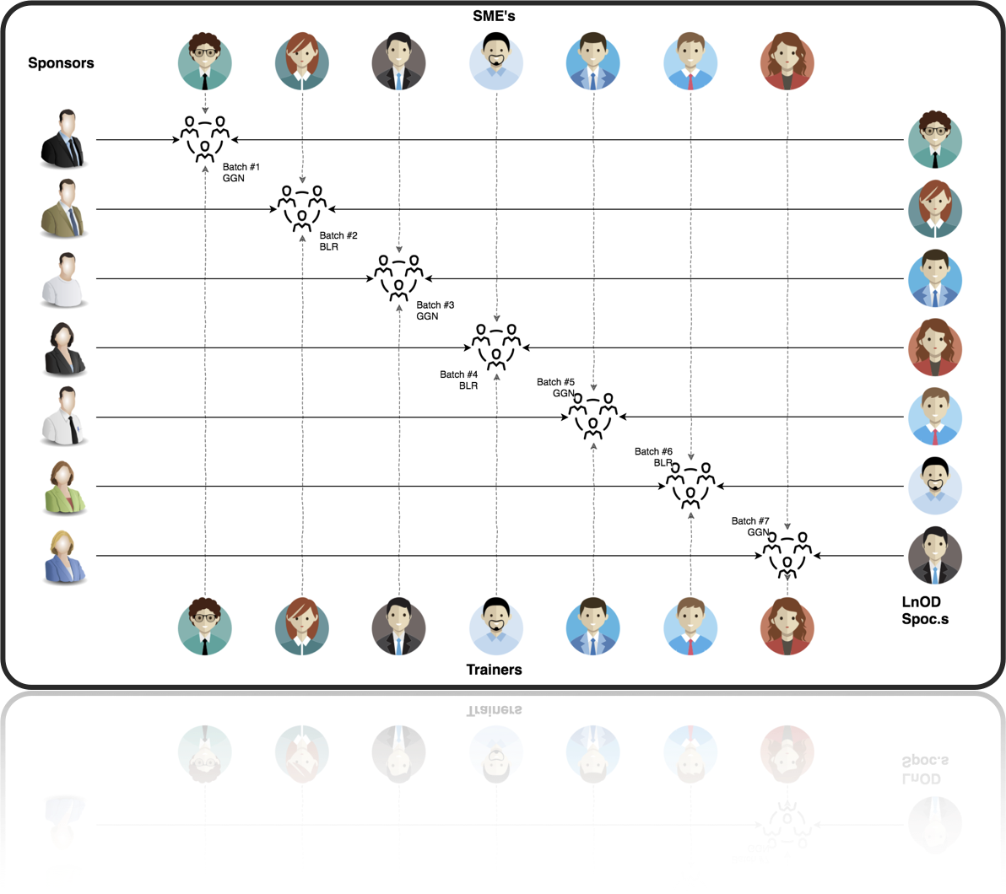
Stakeholders
Sponsors
Flipkart
SME’s
Amit Balyan
Other HRs and Experts
Anushka Khanna
Raksha Dubey

Slide 5
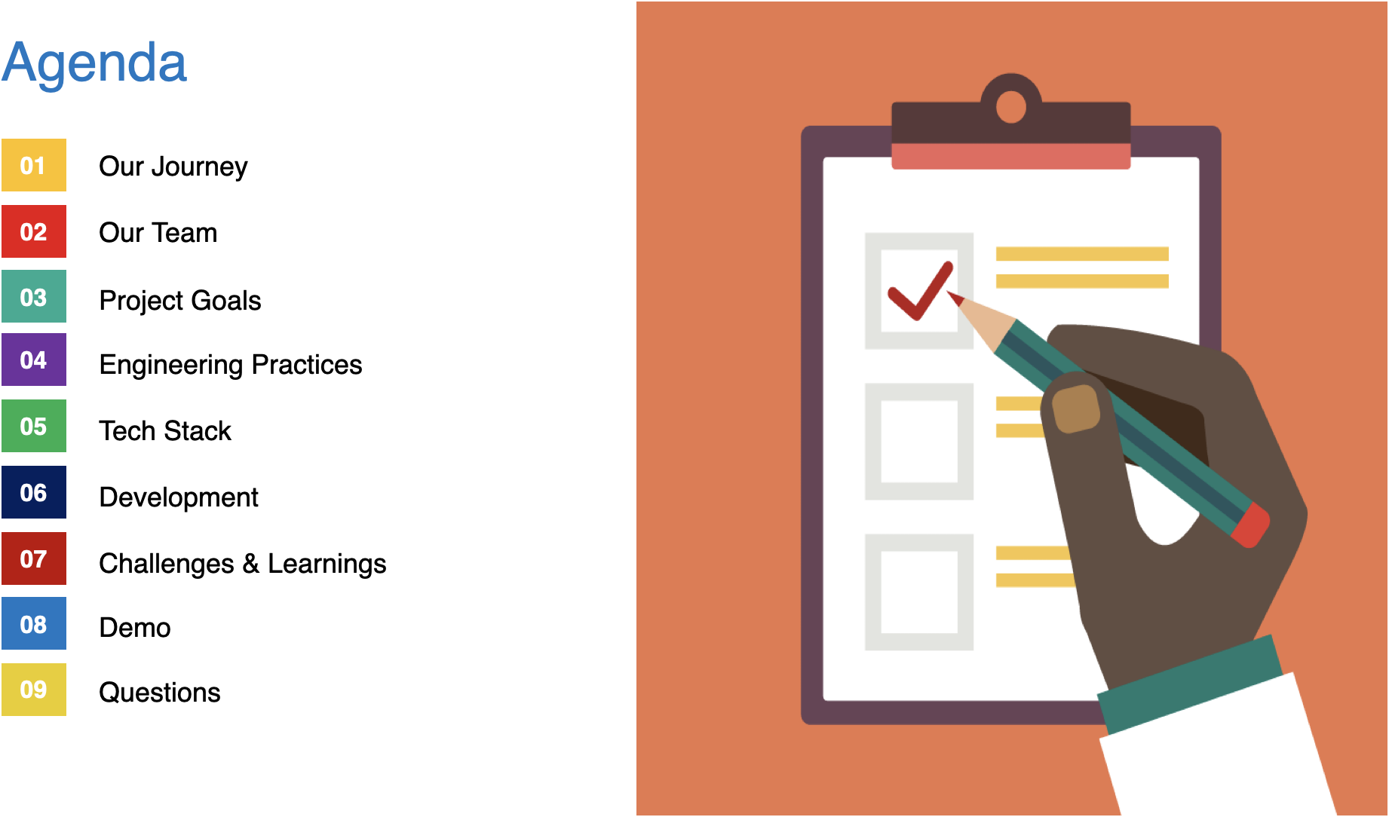

Slide 6
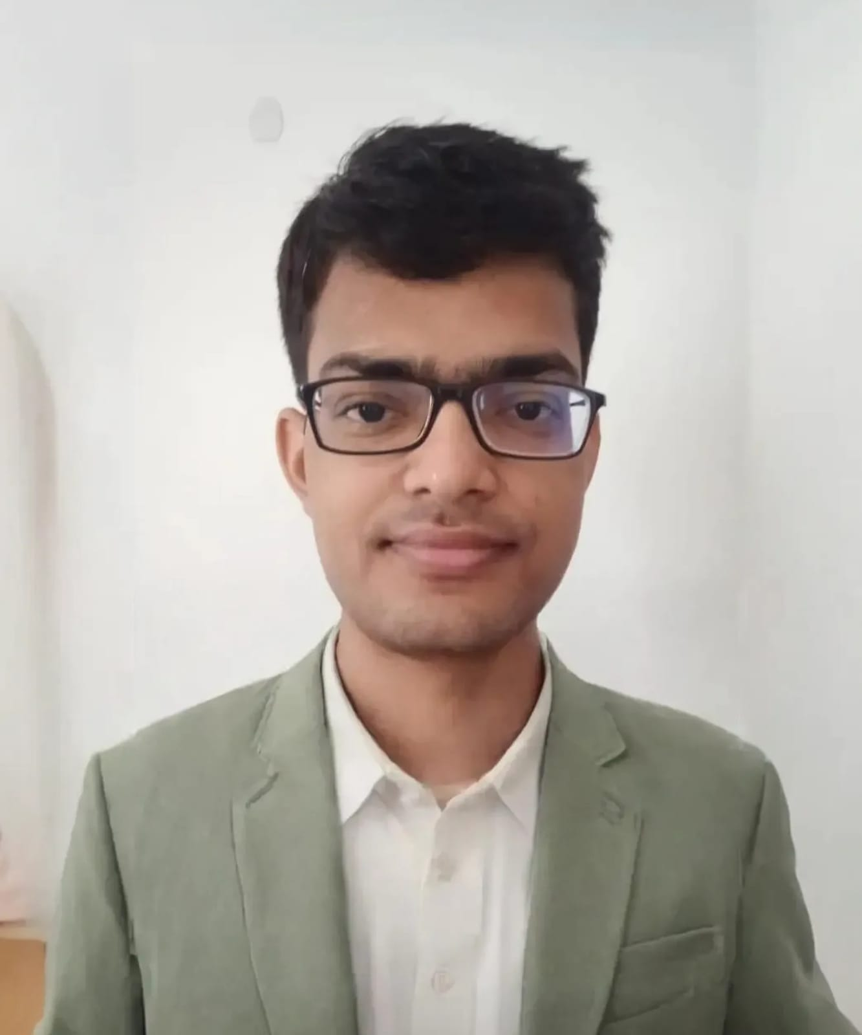
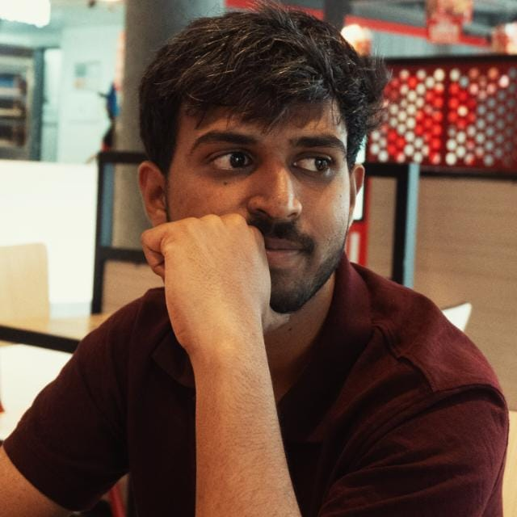
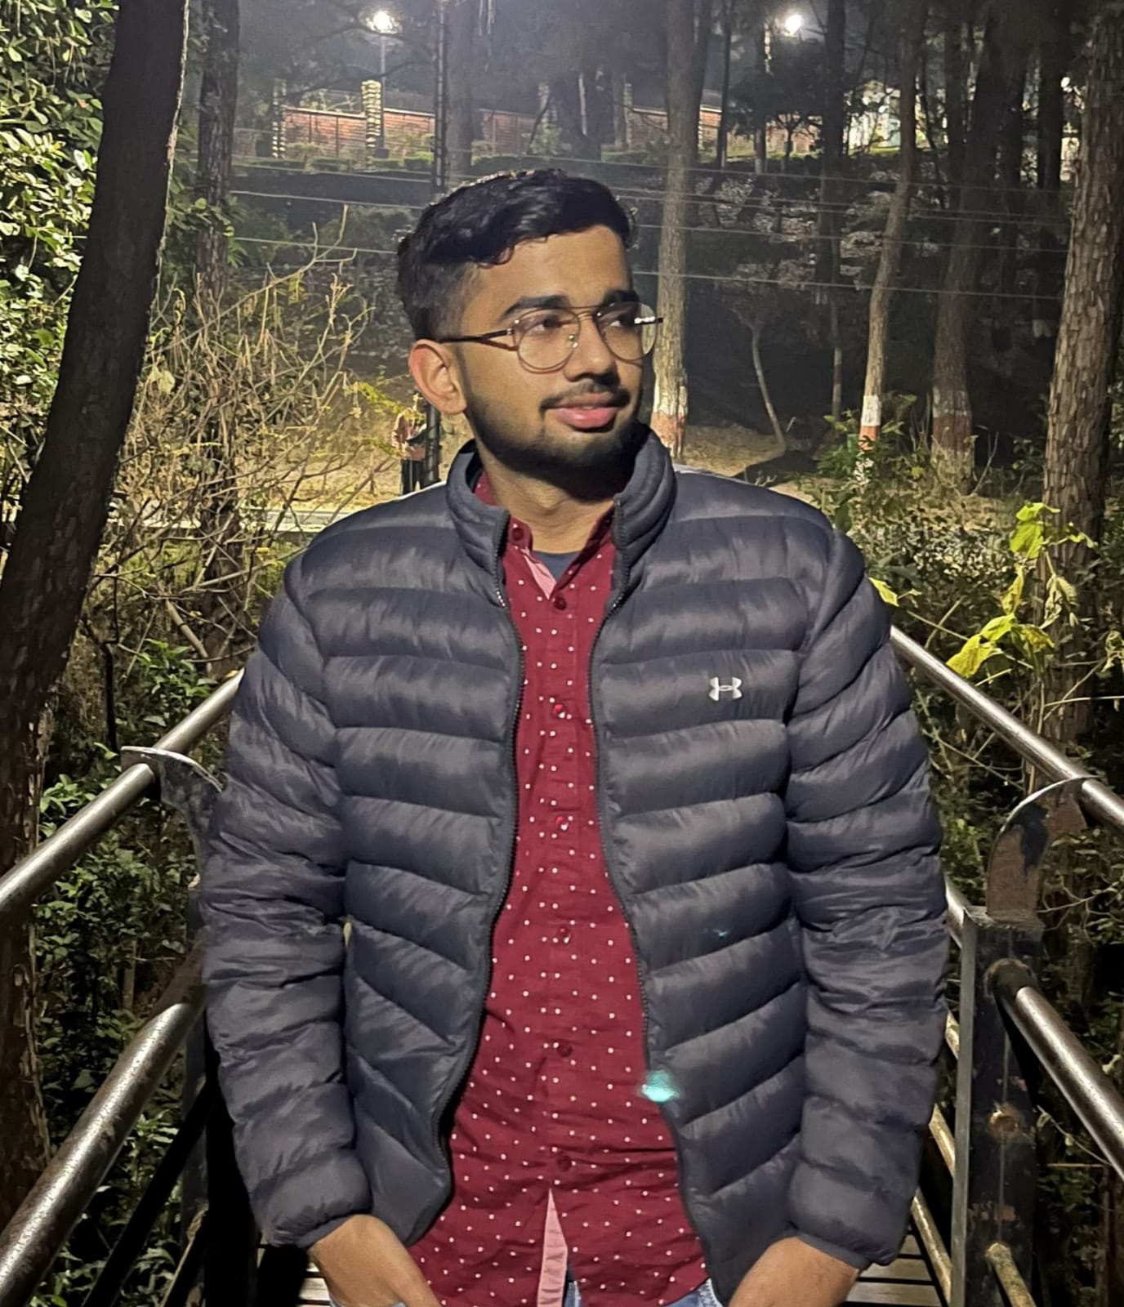
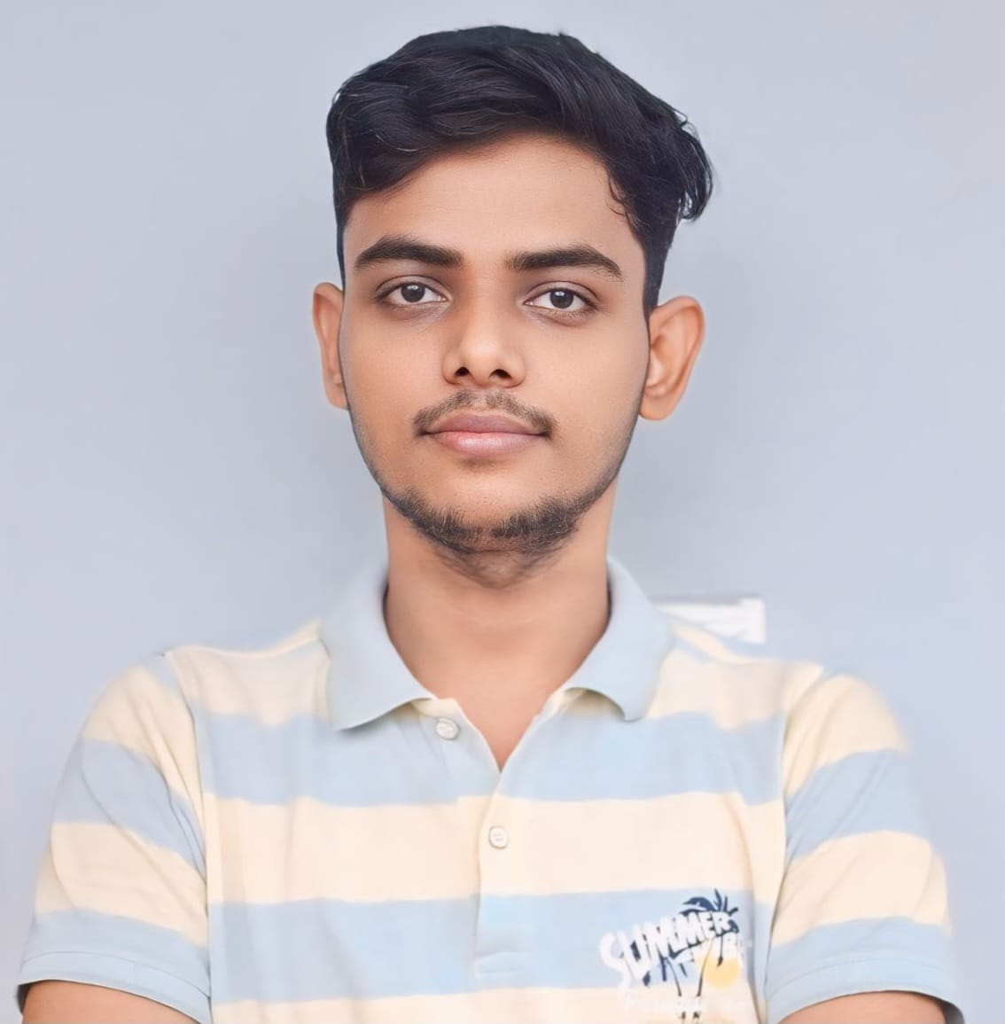


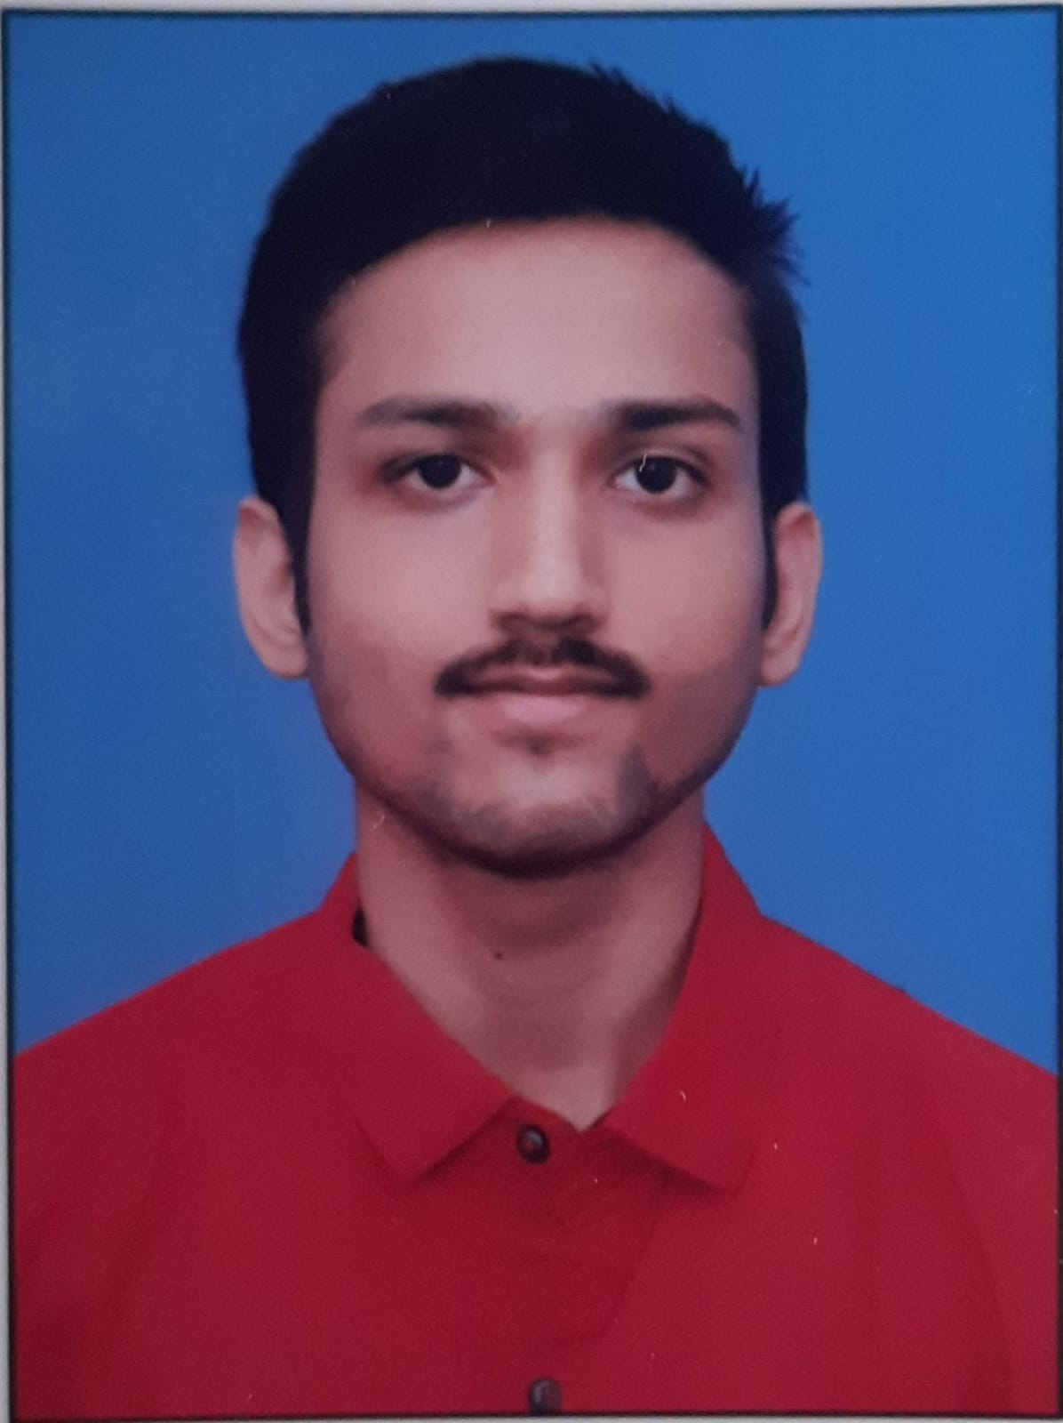
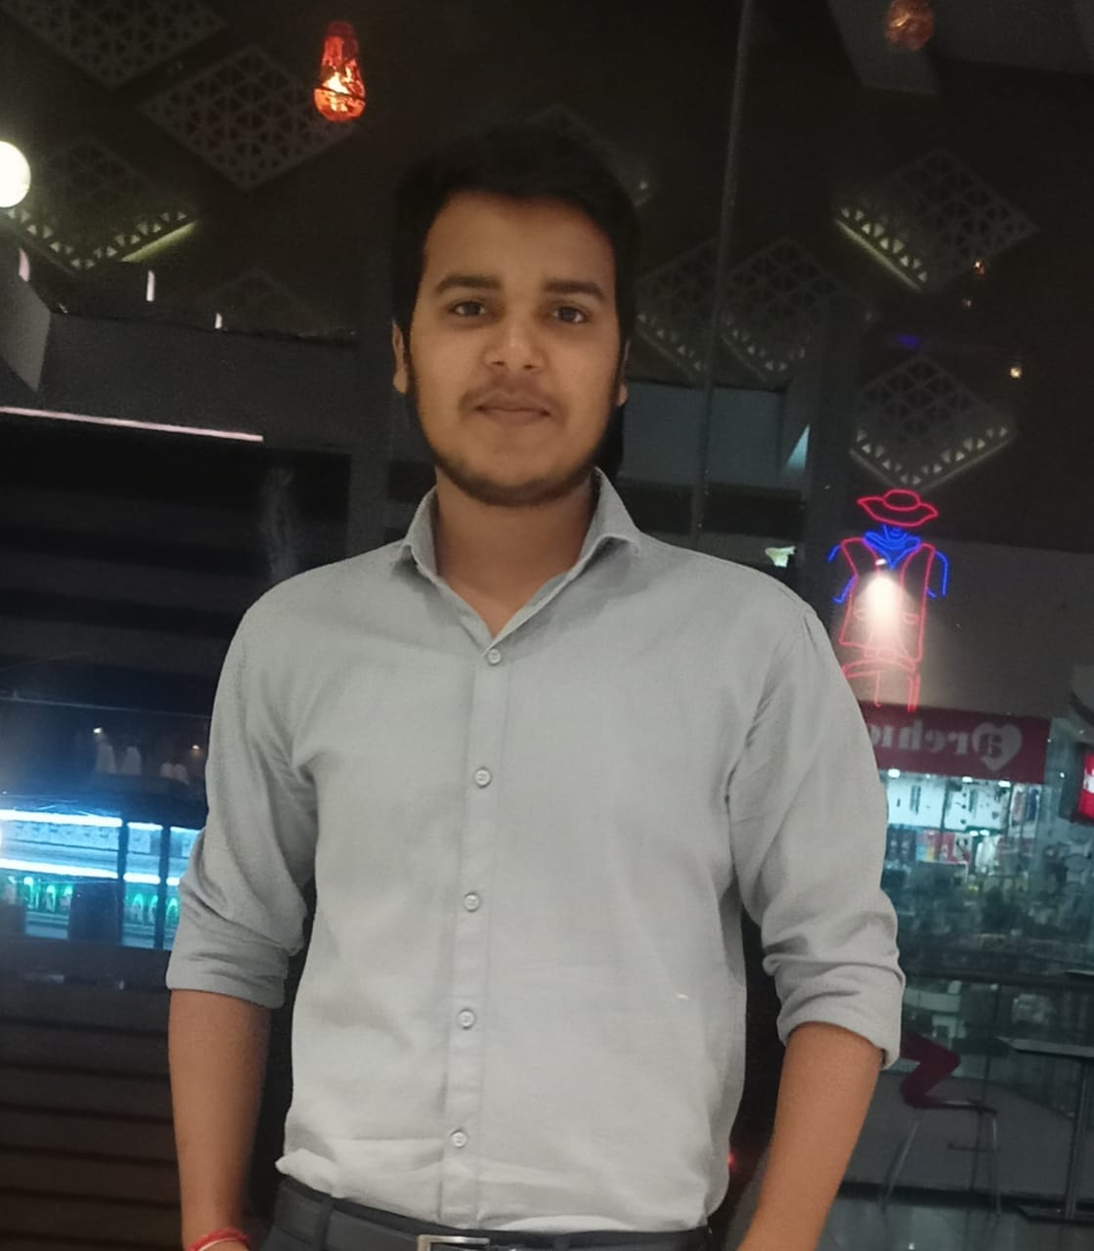
Our Team
Arvind Yadav
Raviteja Racharla
Sanyam Lohan
Shakti Singh
Sabarna Bhowmik
Samarth Bhatt
Pratik singh

Slide 7

Our Journey

Slide 8
Project Goals
To create a robust FlipFit Gym Management System utilizing development tools and technologies, allowing both gym owner and customers to effortlessly manage and access a range of gym services and products.
The FlipFit Application allows users to view all available gym centers in a given city, enabling them to select a convenient center and choose a preferred time slot by checking its availability.

Slide 9
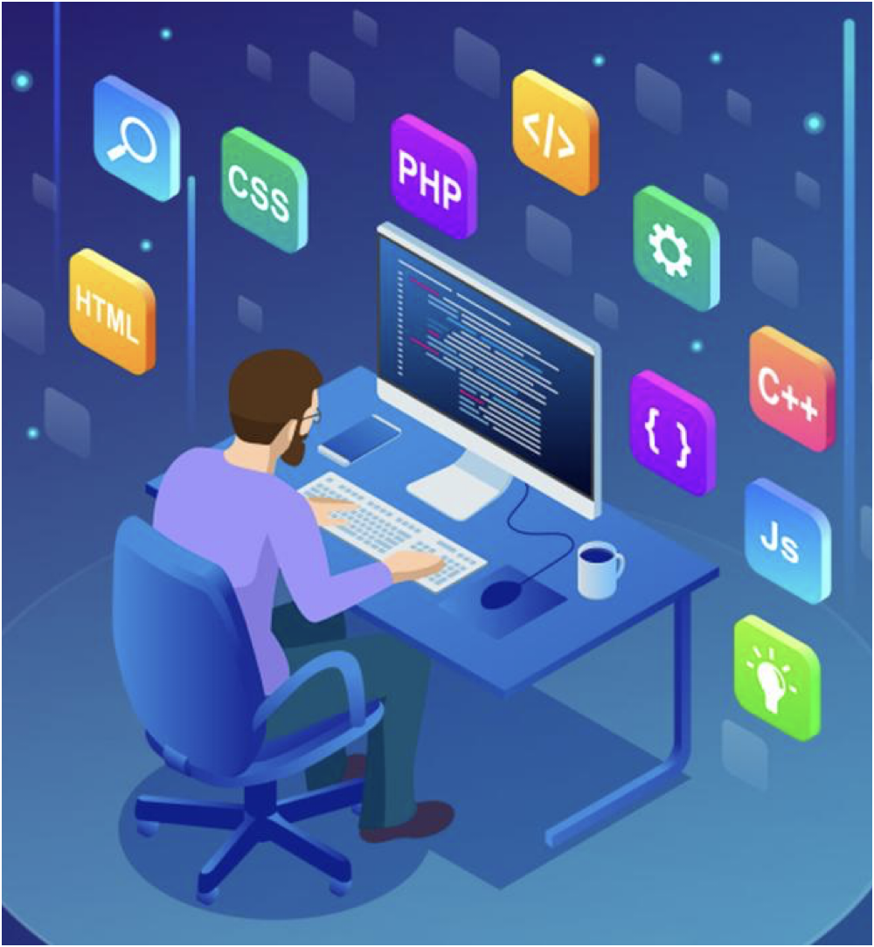
Tech Stacks

Slide 10
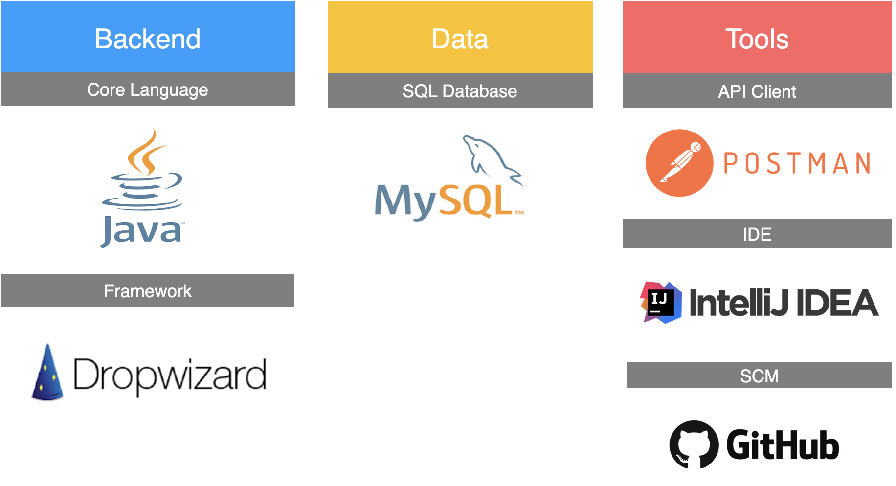


Slide 11
Our Approach
Starting with introduction, discussing the prior skills and training of each team member.
Brief overview of the project and the tech stacks being used along with installation of the softwares.
Throughout the project, we focused on different components and discussed on each part of project to be included and the role of that part in the entire application.
Creation of the model diagrams -Use Case Diagram, Class Diagram, Activity Diagram
As the project progressed, we introduced changes to the application based on the needs and further implementation.
Everyday with SME/Trainer discussion of Project progress & Transformation based on UML & Technologies

Slide 12
Development
FlipFit aims to address the following key objectives:
Streamlined Booking Experience: Simplify the process of booking gym slots across multiple centers in Bangalore.
Optimized Resource Management: Efficiently manage gym resources such as available slots.
Enhanced Partner Engagement: Build strong relationships with gym owners by offering a comprehensive platform that enables them to manage bookings and optimize resource effectively.
Customer Satisfaction: Improve customer satisfaction by offering transparent information on available slots, seamless booking processes.

Slide 13
Features of FlipFit Application
Gym owners from various centers can register their gyms and efficiently manage their businesses.
Users can check the slots available in various gyms and choose according to their time, region and affordability.
The credibility of the gyms are managed by the admin by verifying and approving the gym owners’ details.
Booking of Slots in a Gym according to users convenience and availability in gyms.
Users can cancel their bookings and choose another slot if they need to make a change.
A database is used to store information about gym centers and bookings, with no in-memory storage
Once the seats get filled up, there is a waiting list.

Slide 14
Project Structure
Beans: Initialisation of classes and their setter and getters- Used for schema and row mapping in JDBC.
Client: Added controller/frontend logic code which works in command line terminal. It acts as the entry point of FlipFit application
Business: Working logic of the FlipFit features in the backend.
DAO: Storing and retrieving of data from MYSQL database using queries.
Exceptions: Custom exceptions designed to handle missing data or invalid credentials.
Constants: Contains the mysql queries as constants which can be used in DAO layer thus increasing code reusability
Sql schema: Contains the schema of the tables in database.

Slide 15
Challenges Faced
Adapting to new tech stacks and installing software while learning to work with them.
Integration of different modules of project.
Coordination and Communication among teammates while working through version control system.
Testing and debugging of the code according to changes in schema of database.

Slide 16
Learnings
Team Collaboration and Effective Communication.
Tech Stack: Git, Github, Java, MySQL, PostMan, DropWizard.
Developing a fully working application along with scope of scalability at every stage.
Handling the coupling and interdependence of modules while working of a large level project.
Industrial Development Practices and working under deadline.

Slide 17
Learnings
Continuous code updates and deployment to GitHub using Git commands.
Utilized Java version 17 and APIs, including Date and Time, Stream API, and forEach, for improved application efficiency.
Learnt the need of use case diagrams, class diagrams, activity diagram before starting the project.
Understood the need of proper commenting of code and documentation while working on a project that is being completed in stages.

Slide 18
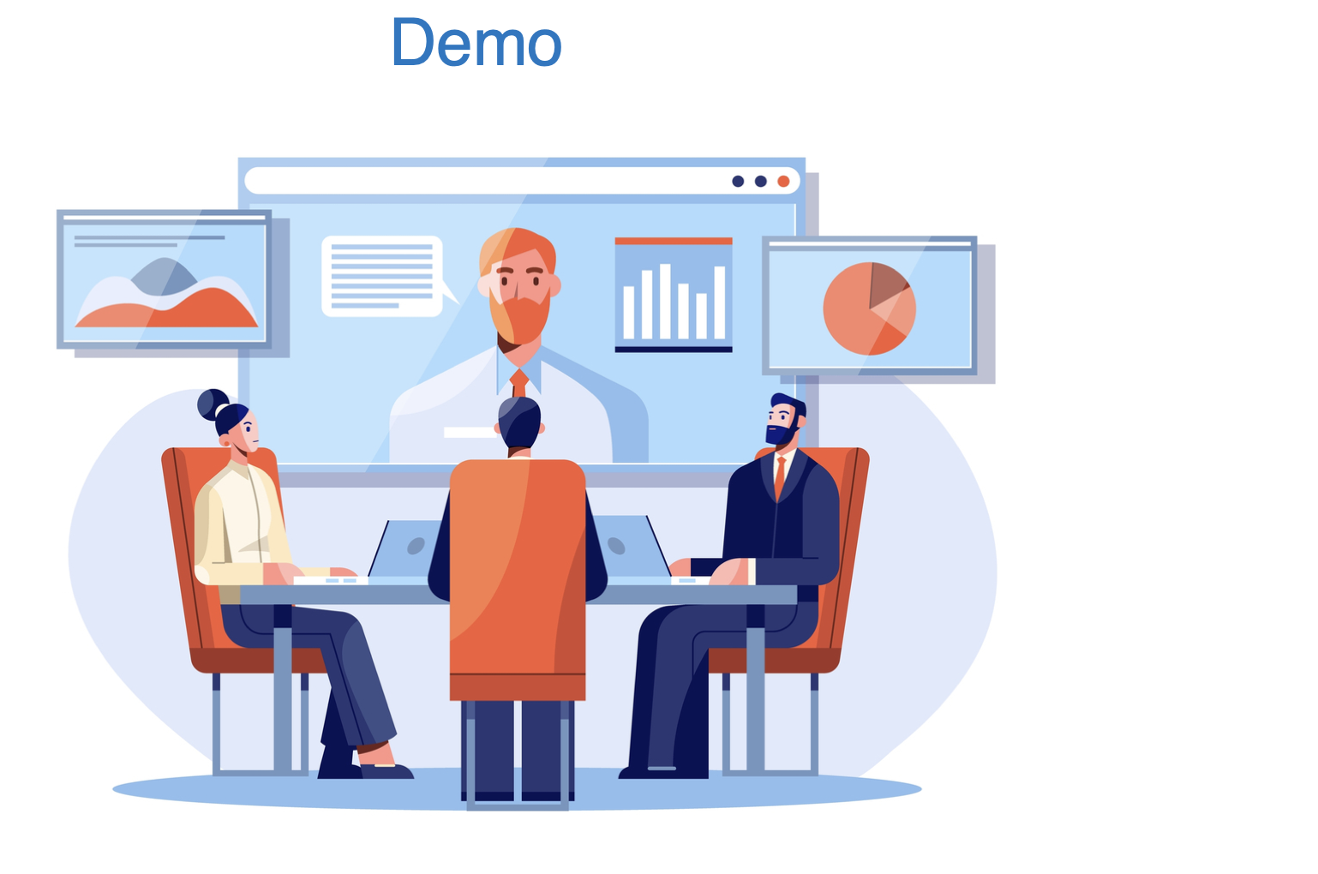

Slide 19

Q&A

Slide 20
Thank you!!

